Slide 1
The Famous 5 Equations
For Constant Acceleration

Slide 2
Consider Acceleration
Δv
Recall:
Expand:
Rearrange:
a
=
Δt
v_{f} - v_{i}
a
=
Δt
v_{f}
=
v_{i}
+
a
Δt

Slide 3
The First Equation
What variables are contained in the equation?
v_{f} (final velocity)
v_{i} (initial velocity)
a (acceleration)
Δt (elapsed time)
But what if we need to find Δd ?
v_{f}
=
v_{i}
+
a
Δt

Slide 4
We Need More Equations
The first equation is no good if we need to find Δd
We need another equation!
Fortunately we have five equations for uniform acceleration.
See next slide…
v_{f}
=
v_{i}
+
a
Δt

Slide 5
Enter the 2nd Equation
(
)
v_{f}
v_{i}
This equation solves our problem for Δd
But it is no good if we need to find a
Unfortunately, none of the five equations solves all problems.
Each equation has its own strengths and weakness
-
Δd
=
Δt
2

Slide 6
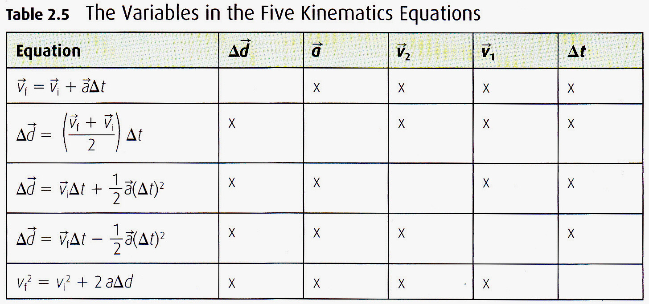
All Five Equations
There are five main variables (thus five equations)
Each equation includes four variables
Each equation is missing one variable

Slide 7
Strategy For Solving Problems
Read the question
List the given variables
You usually will be given three
List the required variable
You usually will be asked for one
Choose to use the equation that includes all four variables mentioned in the question.

Slide 8
Question #1
A motorcycle took 6.2 seconds to accelerate to a velocity of 160 Km/h [N]. If it travelled a displacement of 220 m [N], find its acceleration.
Given:
Δt = 6.2s
v_{f} = 160 Km/h [N]
Δd = 220 m [N]
Required:
a = ?
Δd | a | v_{f} | v_{i} | Δt

Slide 9
Choose The Equation
Δd | a | v_{f} | v_{i} | Δt

Slide 10

Question #1
A motorcycle took 6.2 seconds to accelerate to a velocity of 160 Km/h [N]. If it travelled a displacement of 220 m [N], find its acceleration.
Analysis & Solution:
Use the 4th equation of motion.
Δd | a | v_{f} | v_{i} | Δt

Slide 11
Five Equations Worksheet
Complete the worksheet with your group
Apply the following strategy:
Read the question
List the given variables
You usually will be given three
List the required variable
You usually will be asked for one
Choose to use the equation that includes all four variables mentioned in the question.

